Slide 1

Sales Prediction
Case project by : G Nanda Santosh

Slide 2
INDEX
Introduction
Dataset Overview And Data Preprocessing
Average TV Advertising Expenditure
Correlation Between Radio Advertising and Sales
Impact of Advertising Medium on Sales
Linear Regression Model and Visualization
Sales Prediction for New Expenditures
Normalization and Model Performance
Radio and Newspaper as Predictors
Conclusion

Slide 3
Introduction:
In the dynamic landscape of marketing, understanding the relationship between advertising investments and product sales is paramount. Our dataset provides a glimpse into this intricate dance, where dollars spent on TV, radio, and newspaper ads intersect with actual sales figures.
We’ll calculate averages, explore correlations, and visualize predictions.

Slide 4
Dataset Overview And Data Preprocessing:
Overview :
Our dataset contains information on advertising expenditures across three mediums:
TV, Radio, and Newspaper.
The target variable is “Sales,” representing the number of units sold.
We’ll analyze how different advertising channels impact sales.
Preprocessing:
Prepares the data for analysis with the help of required libraries in python (pandas, numpy, mathplotlib, seaborn, sklearn)

Slide 5
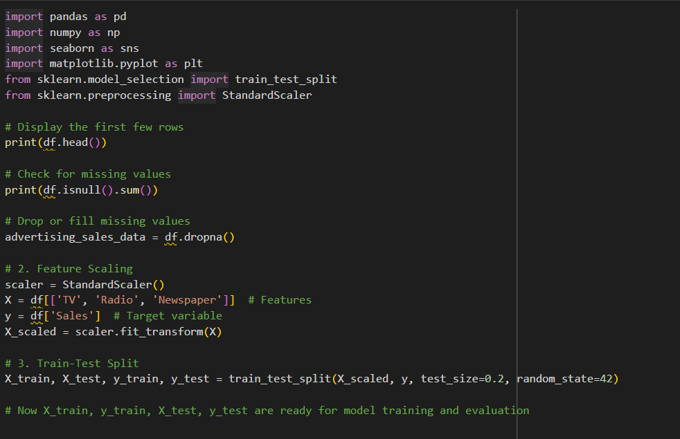
Code(python):
.

Slide 6
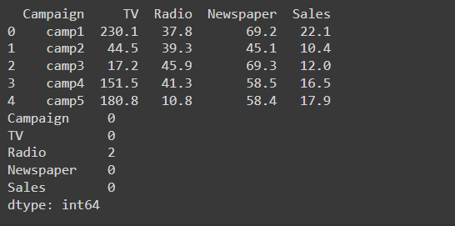
Output:

Slide 7
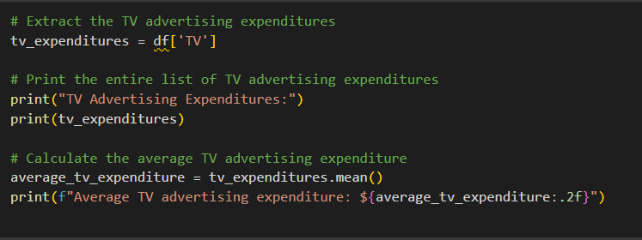
Average TV Advertising Expenditure
We’ll calculate the average amount spent on TV advertising.
This provides insights into the typical investment in TV campaigns.
Code:

Slide 8
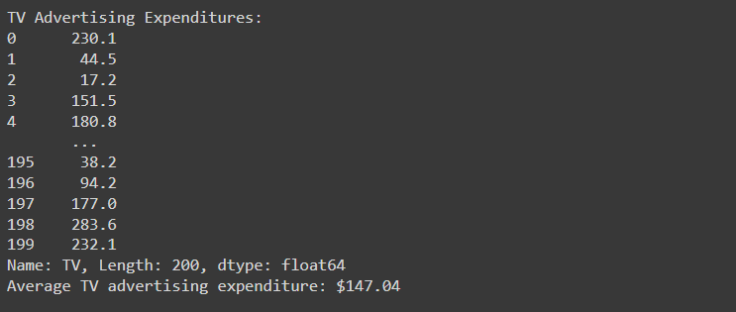
Result:

Slide 9
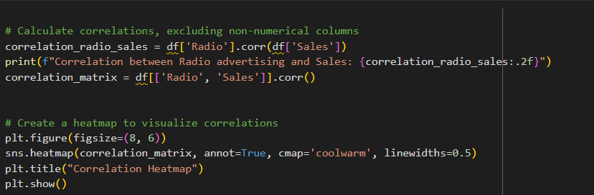
Correlation Between Radio Advertising and Sales
We’ll examine the correlation between radio advertising expenditure and product sales.
Positive correlation suggests that higher radio spending corresponds to increased sales
Code:

Slide 10
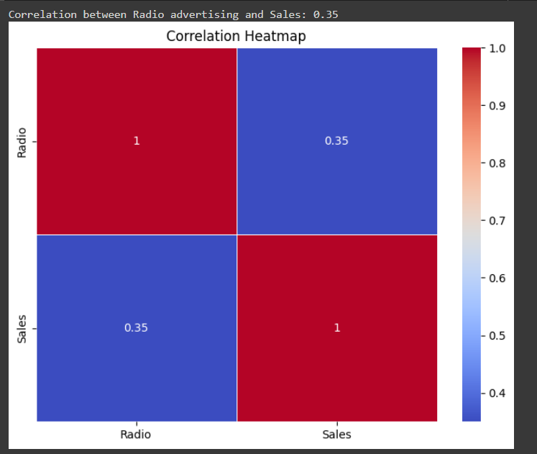
Result:
.

Slide 11
Impact of Advertising Medium on Sales
Using linear regression coefficients, we’ll determine which medium has the most significant impact on sales.
Coefficients reveal the strength of association between each medium and sales.
Ploting the linear regression line based on Impact of Advertising Medium on Sales

Slide 12
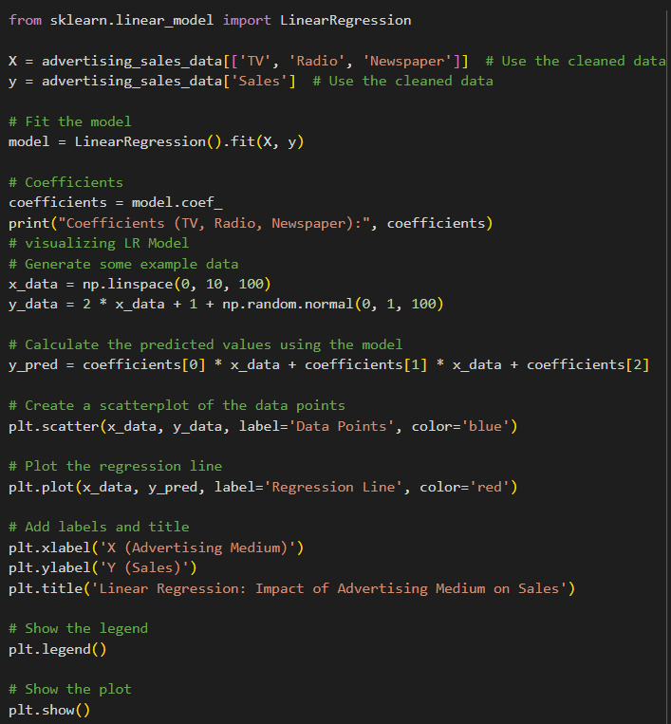
Code:

Slide 13
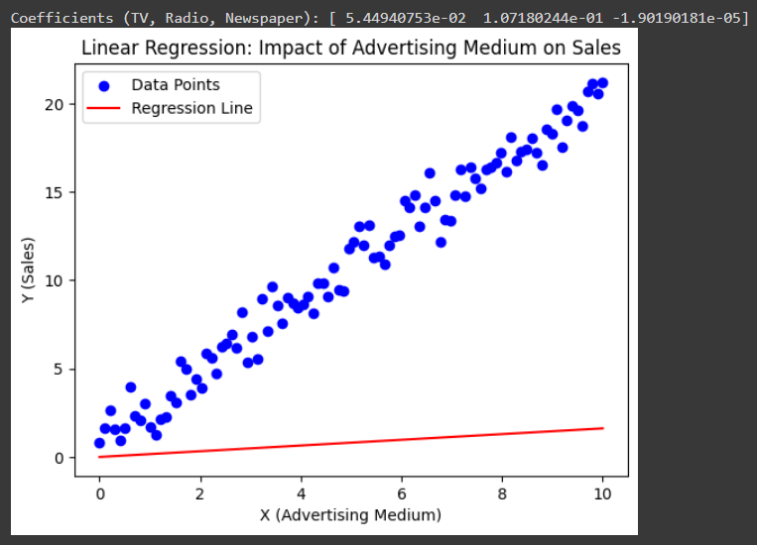
Result:

Slide 14
Linear Regression Model and Visualization
Purpose:
linear regression helps us uncover relationships and make predictions, making it a fundamental tool in statistical analysis.
Explanation:
We’ll build a linear regression model using all variables (TV, Radio, Newspaper) to predict sales.
Visualizing the regression line helps us understand the relationship between advertising expenditures and sales.

Slide 15
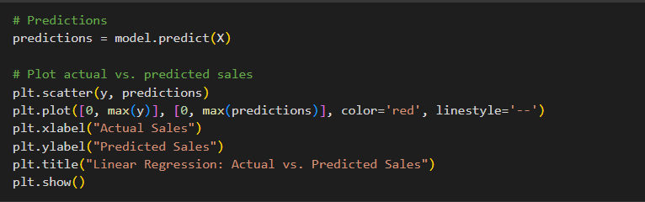
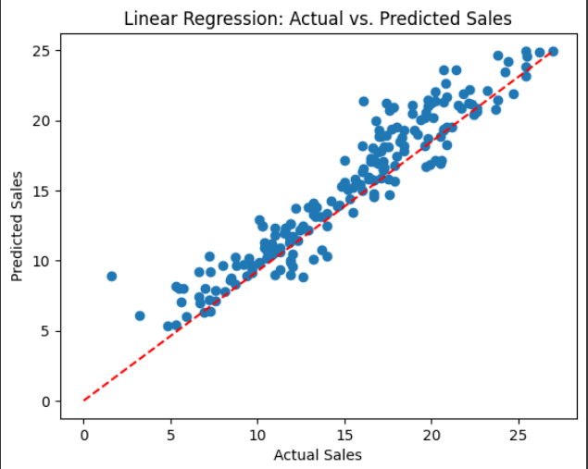
Code & Result:

Slide 16
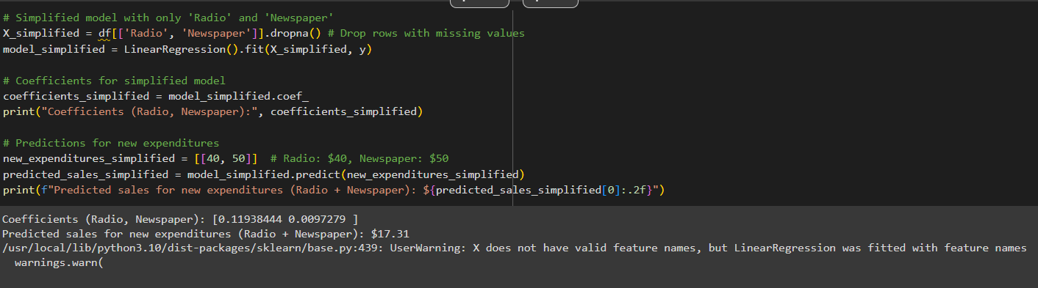
Sales Prediction for New Expenditures
Using our trained model, we’ll predict sales for a new set of advertising expenditures.
explore how different spending levels affect sales.
Code & Result:

Slide 17
Normalization and Model Performance
Normalization:
Purpose: Ensures consistent scales for features (variables) in the dataset.
Methods: Min-Max Scaling, Z-Score (Standardization), Robust Scaling.
Why?: Helps algorithms work better with features of varying magnitudes.
Model Performance:
Metrics: Use accuracy, precision, recall, F1-score (classification), RMSE (regression).
Cross-Validation: Evaluate models robustly.
Overfitting/Underfitting: Monitor for balanced performance.

Slide 18
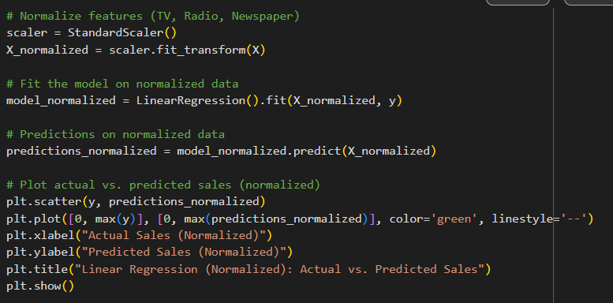
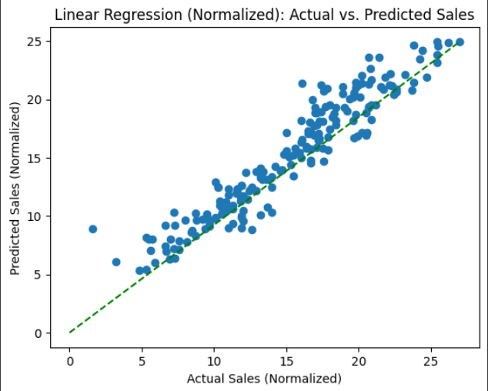
Code & Result:

Slide 19
Radio and Newspaper as Predictors
we consider only radio and newspaper advertising expenditures.
We’ll evaluate their combined impact on sales.
Code & Result:

Slide 20
Conclusion:
Our analysis of the Sales Prediction dataset revealed valuable insights:
Average TV advertising is : $147.04
Correlation between Radio advertising and Sales is : 0.35
Coefficients (TV, Radio, Newspaper): [ 5.44940753e-02 1.07180244e-01 -1.90190181e-05] from this we can say TV advertising medium has the highest impact on sales based on the dataset.
Visualized Linear Regresion line that includes all variables (TV, Radio, Newspaper) to predict Sales, and visualize the model's predictions against the actual sales values.
Predicted sales for new expenditures is: $19.82
normalization enhances model stability, convergence, and generalization, leading to better performance.
Predicted sales for new expenditures (Radio + Newspaper) is : $17.31

